Slide 1

Spectra

Slide 2
UI 1:Student
Notes:
UI 1: Student Tasks
· Tell your teacher how you are feeling today and why.
· Change your mood to a different mood.

Slide 3
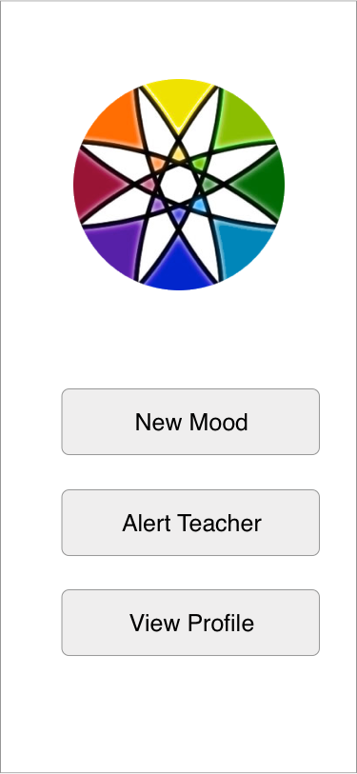

Slide 4
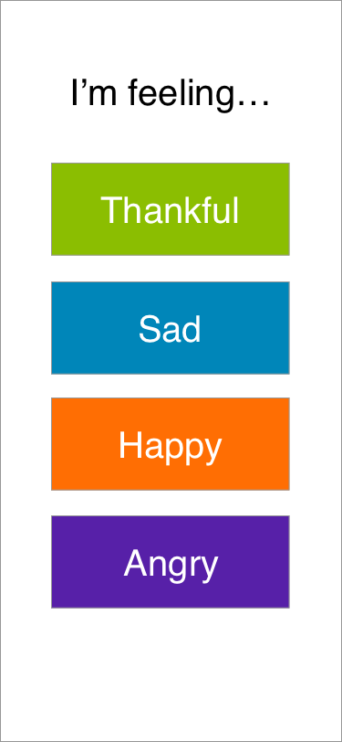

Slide 5
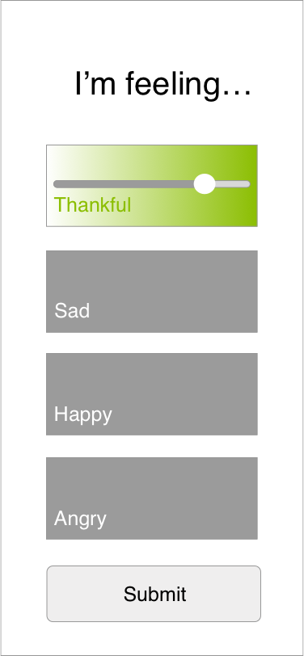

Slide 6
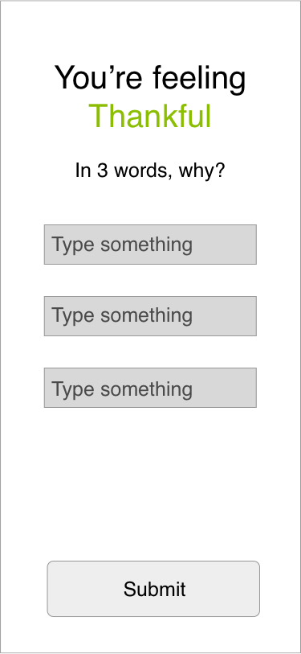

Slide 7
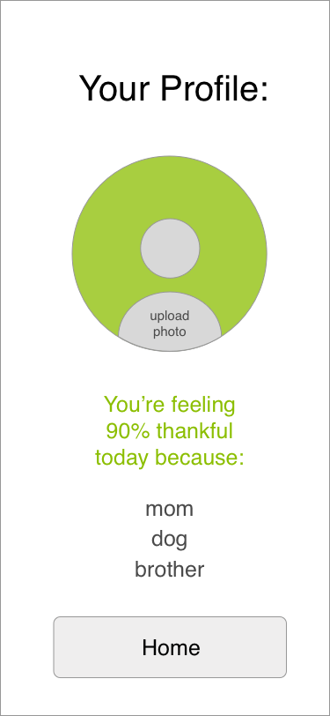

Slide 9
UI 1:Teacher
E
Notes:
UI 1: Teacher Tasks
· Contact Jacky Smith’s Parents
· Find out how Jacky Smith was feeling on Friday

Slide 10
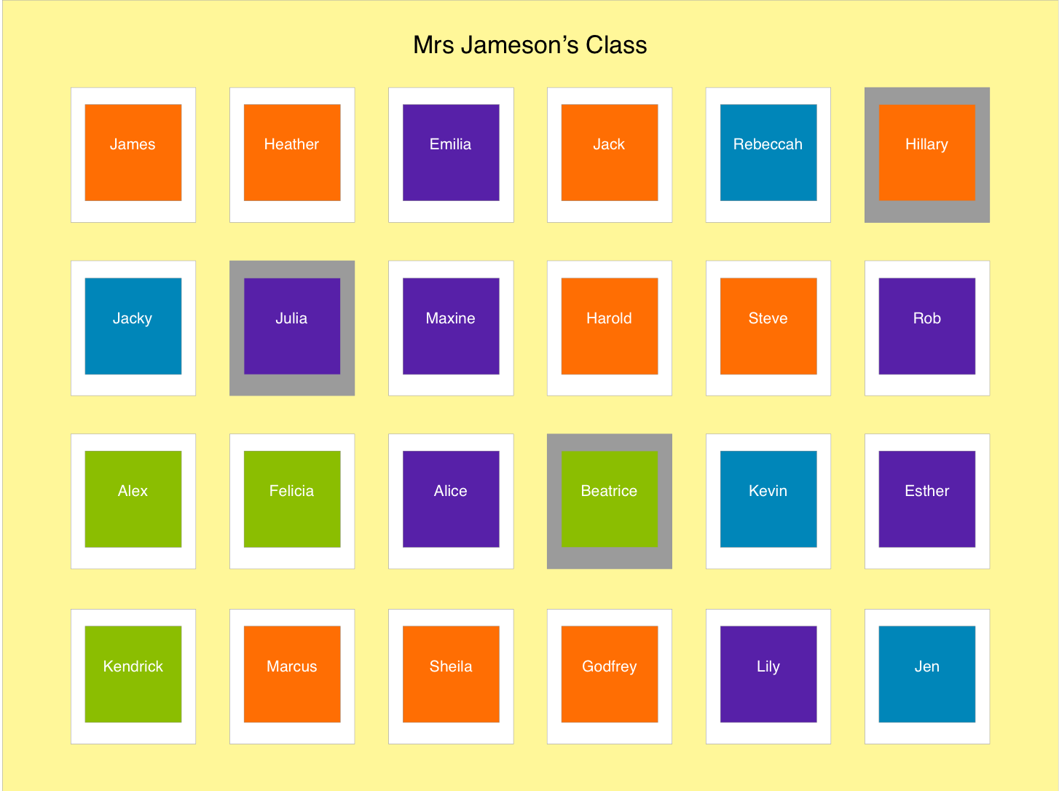

Slide 11
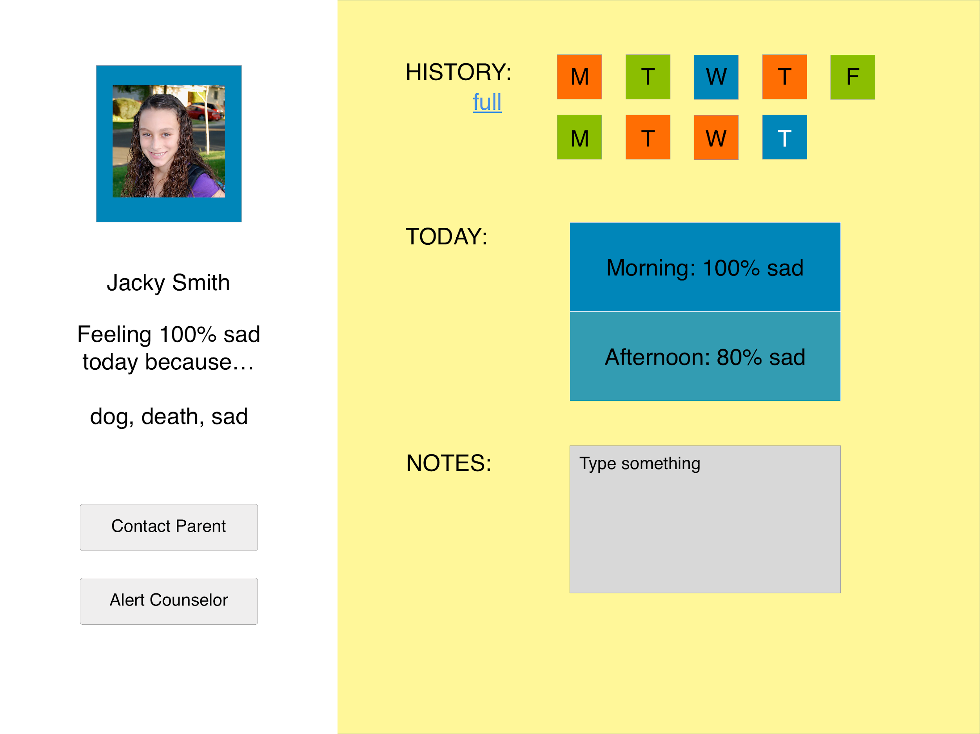

Slide 12
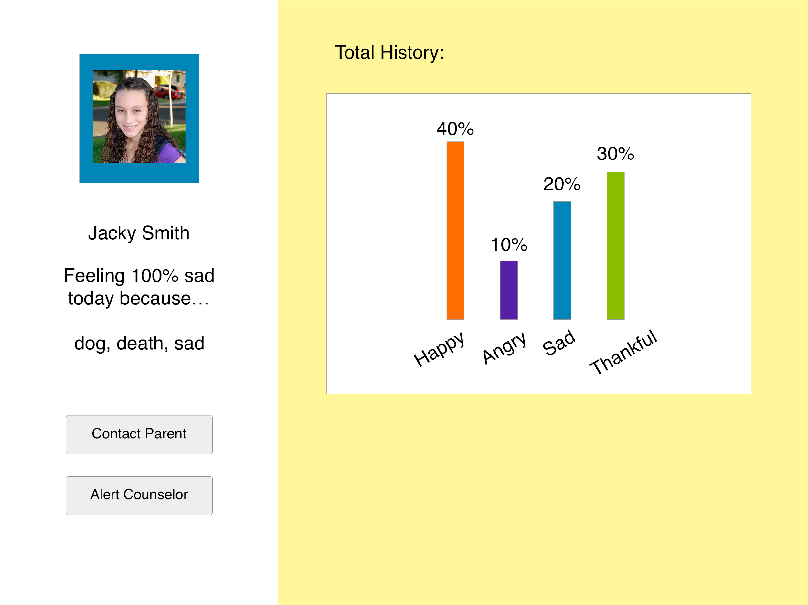

Slide 13
UI 2: Student
E
Notes:
UI 2: Student Tasks
· Tell your teacher how you are feeling today and why.
· Send your teacher a message.

Slide 15
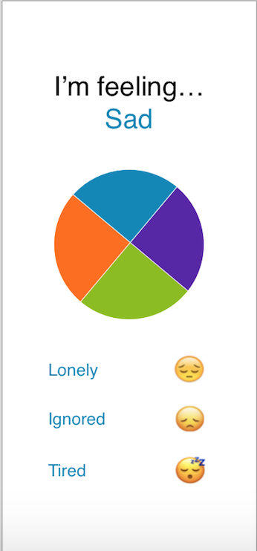

Slide 16
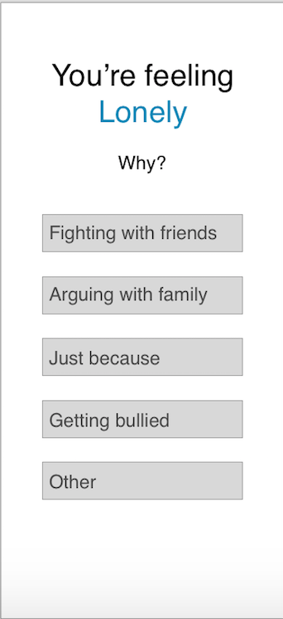

Slide 17
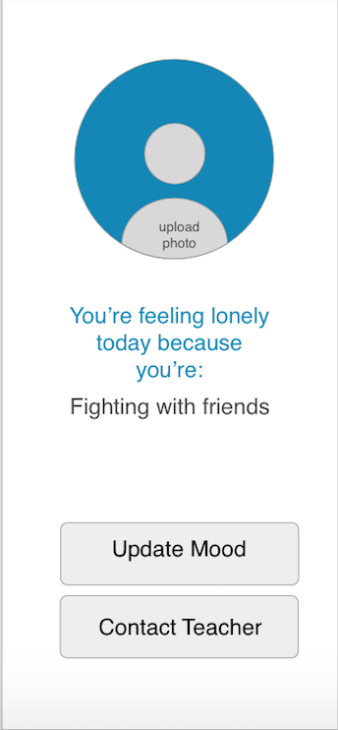

Slide 18
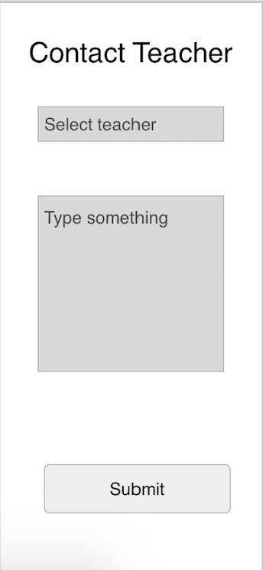

Slide 19
Notes:
Need to know where to put the notes

Slide 20
UI 2: Teacher
E
Notes:
UI 2: Teacher Tasks
· Respond to Jacky Smith’s message
· Find out how Jacky Smith is feeling today

Slide 21
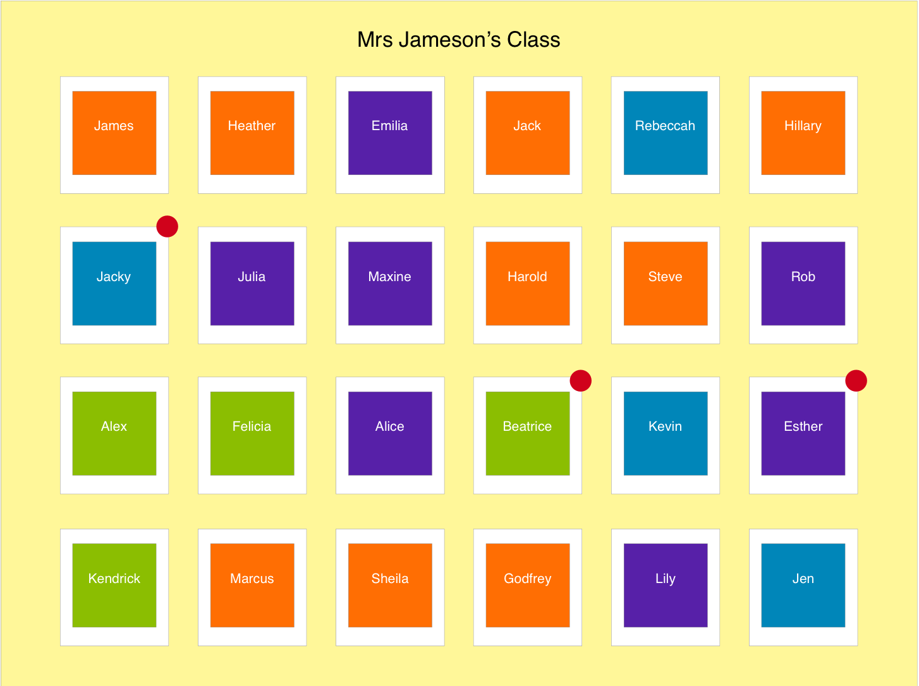

Slide 22
